Slide 1




Leaning ILLs at Nottingham
Lynn Brown & Celia Hudson
Senior Librarians, Customer Services
The University of Nottingham

Slide 2


Today’s session
ILLs at Nottingham
Lean
A bit of theory
The stages of Lean and how we’re applying these to ILLs
The benefits of Lean
A chance to have a go!

Slide 3
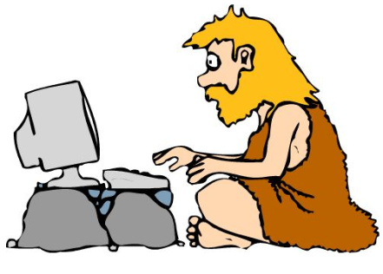

ILLs at Nottingham
Online ILLs requesting mid-1990s: LIBERTAS
£1 charge and quota system introduced in 1996
50,000 (1996) 12,000 (2015)
Service changes in 2011

Slide 4


Changes in 2011

Slide 5
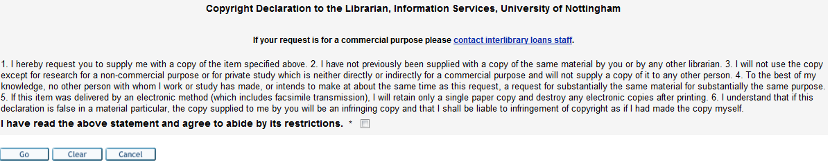
Changes in 2011

Slide 6


Changes in 2011

Slide 7


ILLs User Survey
ILL staff have always been super helpful and extremely pleasant to deal with
My experience has been so bad that I have never actually ended up reading anything that I requested. Now I don't bother using the system, I just buy the resources or forget about them

Slide 8


ILLs User Survey
The current scheme is a lot of hassle and not very efficient. There has to be a better way.
The voucher system is prehistoric!

Slide 9

ILLs User Survey
Books have been delayed by months with no communication or alternative
I have had hard-to-get items that have remained pending for ages due to a request for input from me, but I have never been notified. A better follow-up system on requests might help with this.

Slide 10

ILL User Survey
I'm in total awe of ILL; it seems amazing that you can request almost anything, however obscure, and get it - usually very quickly. It must surely rank alongside the pyramids as one of the Wonders of the World.

Slide 11

ILLs Review 2015
Lean the service !

Slide 12
Lean Management techniques
It feels like a really democratic process ... staff from all levels seem to be represented & involved
It works because staff believe in it and can see that it has delivered positive results & changes
It appeals to us as we have so many procedures, with so many details that don’t always need to be there
I think it works, because it makes us stop to think why we are doing certain things in a certain way
As library people we tend to want focus on the detail and to keep information longer than we might need. Leaning challenges this
We have lots of processes that may have been in place for many years, some of which have been changed slightly but have never had a very good ‘going over’ to check they are still fit for purpose!
It filters through to all aspects of your life
(I’ve leaned my mum’s pantry ! )

Slide 13
What is Lean?
Lean – Toyota/Ford; phrase coined in 1990
Lean is the set of "tools" that assist in the identification and steady elimination of waste. As waste is eliminated quality improves while production time and cost are reduced.
We use Lean techniques to analyse the provision of a service, identify and eliminate non-value adding processes known as ‘waste’, and focus on activities which add value to the customer.
Notes:
When people think of lean manufacturing they normally think that it began with Toyota and some go as far back as Ford and his production lines for the Model T ford. Whilst the principles are old the terminology ‘Lean’ is relatively recent - it was not until 1990 that we were introduced to the term Lean Manufacturing.
So what is Lean?
Lean is the set of "tools" that assist in the identification and steady elimination of waste. As waste is eliminated quality improves while production time and cost are reduced.
So how does this translate into services and what we do?
We use Lean techniques to analyse the provision of a service, identify and eliminate non-value adding processes known as ‘waste’, and focus on activities which add value to the customer. In this way they bring about improvements in the quality of the service received by customers, whilst also making the processes as efficient as possible, and therefore freeing up staff time to focus further on the customer’s needs.
For example, when we leaned BooksDirect we reformatted the slip which is put inside the books which are delivered to the School. This meant that the BD team no longer had to highlight and fold the slip so that the relevant information was prevalent, saving them time and effort, AND this improved the service for the customers because they were able to see quickly and easily who the book was for at their end.
The lean organisation provides the best possible service for its customers by ensuring that they receive the service they want, at the time they want, to the standard they require, which is encompassed in the phrase ‘Customer value’.

Slide 14

The stages of Lean
    Team
    Customer values
    Metrics
    Process mapping
    Identifying waste
    Recommendations
    Implementation
    Review/continuous improvement

Slide 15
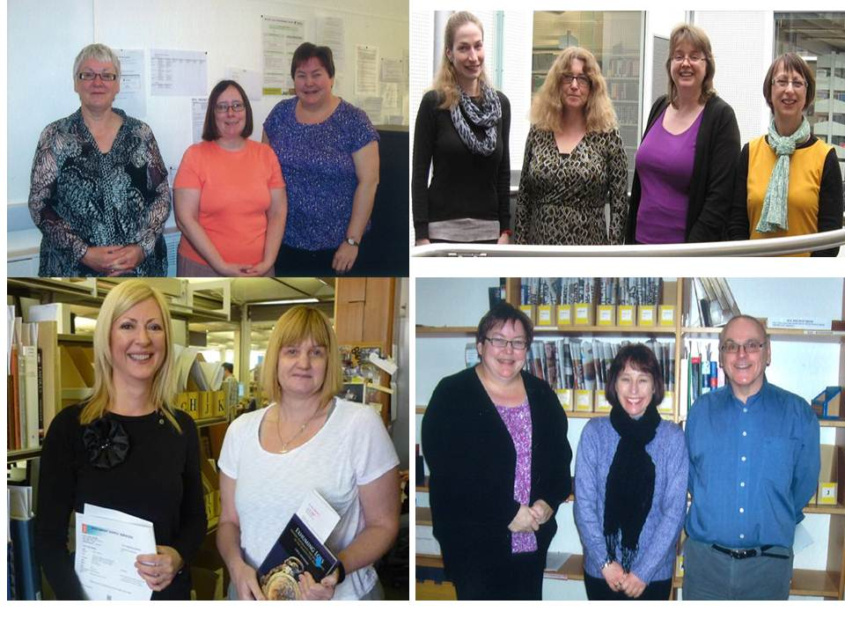
ILLs Team

Slide 16

Customer Values for ILLs
Speed: supply/response
Range/diversity
Ease of request
Convenience: SED
Renewals: ability/ease
Staff knowledge and expertise
Home reading
Aiding research
Value for money

Slide 17
The stages of Lean
    Team
    Customer values
    Metrics
    Process mapping
    Identifying waste
    Recommendations
    Implementation
    Review/continuous improvement

Slide 18

Mapping the process
Start and end
Include all steps/detail
What happens now
Basic step (brief description of action)
Decision – Yes/No question
?
Yes
Step producing a document
Start and end

Slide 19
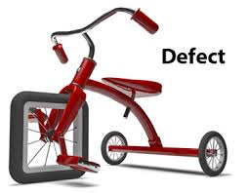

Identifying waste
Transportation
Inventory
Motion
Intellect
Waiting
Over processing
Over production
Defect
Waiting
Inventory

Slide 20
The stages of Lean
    Team
    Customer values
    Metrics
    Process mapping
    Identifying waste
    Recommendations
    Implementation
    Review/continuous improvement

Slide 21

Lean Management techniques - benefits
Simple to understand
Makes it clear why things need to change
The key participants are those who carry out the processes
Structured way to engage staff in change and lead them through it
Makes it easy to justify and promote change
We like ‘process’ so it fits with our way of thinking
Promotes team work
Generates ideas
Gets things done – not just a talking shop
It’s different to the day job and it’s fun!

Slide 22

Questions

Slide 23

Practical
Identify waste categories

Slide 24
Scenario 1
SED article arrives in email box
Article is printed
All pages are checked to make sure there are none missing
The title of the article is highlighted on the front page
A cover sheet is attached to the article
The requester’s name and article title are highlighted on the cover sheet

Slide 25
Scenario 2
Intray response received from BL – ‘CRF’
Response is added to the request log - LMS
Printed Intray sheet is annotated to indicate that the response has been added to the log
Staff contact requester to ask for more information
Staff change the status of the request while waiting for a response

Slide 26
Scenario 3
ILL request for book comes into the supervisor’s mailbox from another Univ library
Supervisor checks the catalogue and passes it on to a member of their team to deal with, with classmark & shelf number details added
Member of the team prints it off and highlights the classmark & shelf number
Member of the team goes to the shelf to find the book
Member of team emails the supervisor to confirm when supplied so that email can be annotated/filed.

Slide 27
Oasis
Don’t Look Back in Anger
Some Might Say
Little by Little
The Importance of being Idle
Roll with it
Whatever

Slide 28
Thank you
Lynn Brown
lynn.brown@nottingham.ac.uk
Celia Hudson
celia.hudson@nottingham.ac.uk
www.nottingham.ac.uk/library

