Slide 1
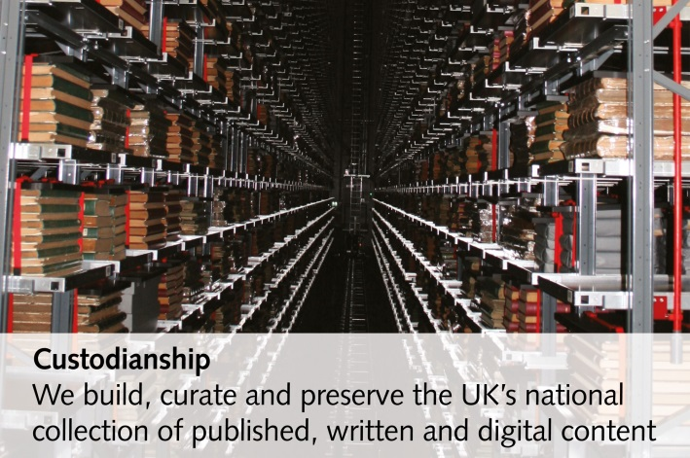
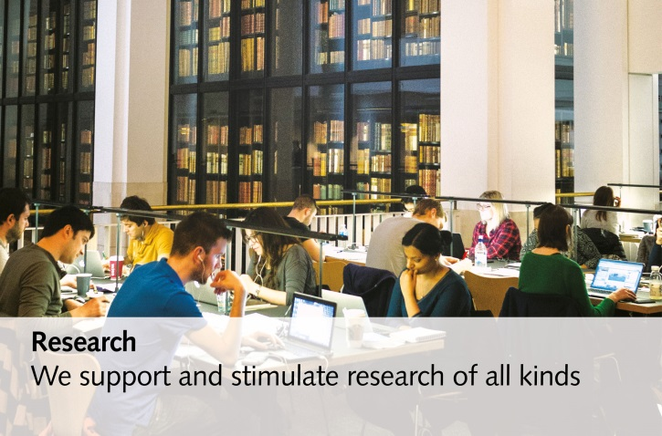
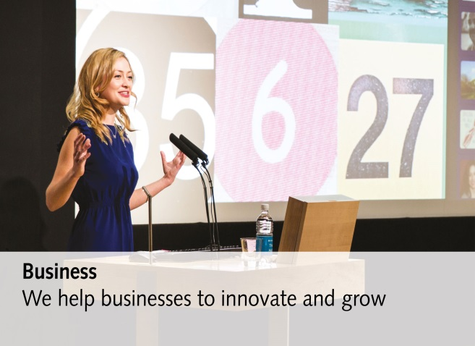
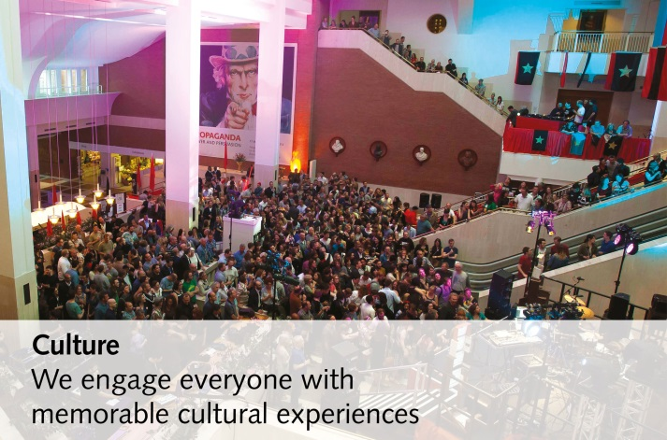
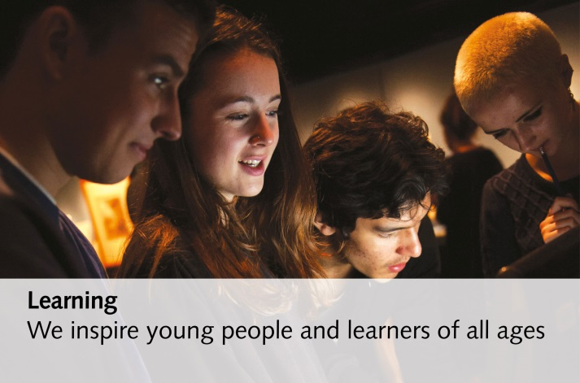
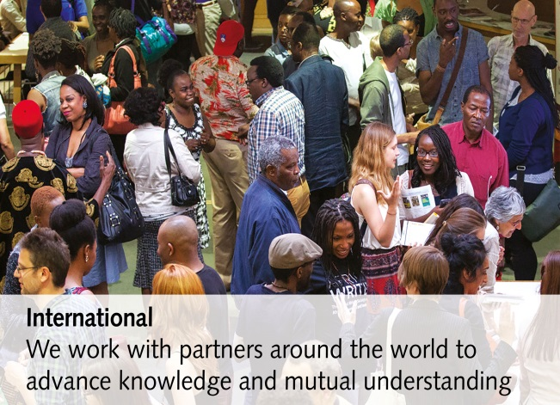
British Library Strategy
Living Knowledge – 6 core purposes

Slide 2

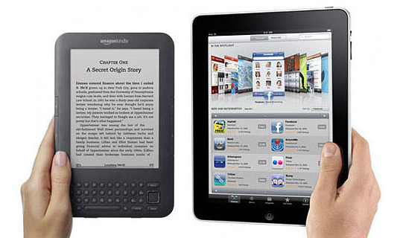
A vast, described collection in various formats
Image: Maria Elena
3 million monographs
Over 48 million journal articles
0.5 million Doctoral theses and dissertations
5 million research reports and official publications
Over 12.5 million digital items, available to download immediately
All available
on demand
?

Slide 3

B2B Content and technology partnerships
BL designed an xml based Application Programming Interface (API).
Machine to machine communication.
Ability to build in customer workflows.
Enables it to act as a hub in a growing network of information providers through partnership.

Slide 4
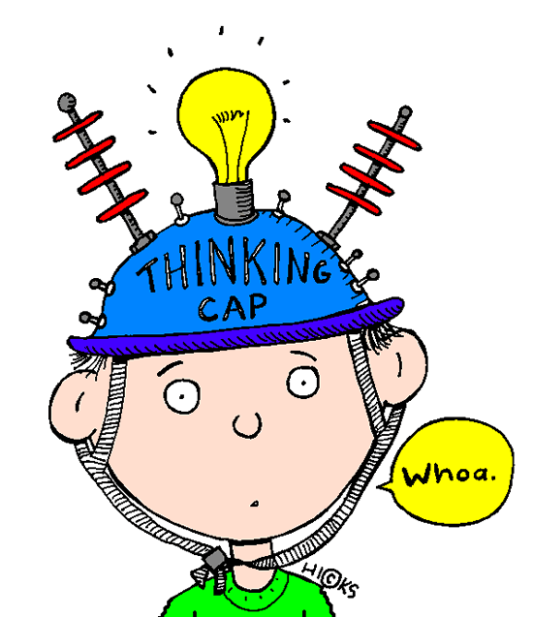
Your thoughts!

Slide 5
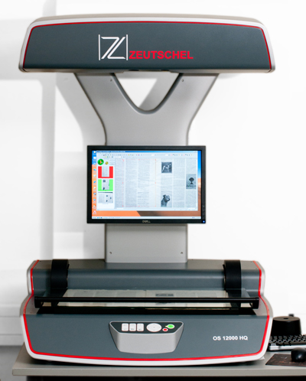
Enhanced Higher Education Supply Service (EHESS)
What is EHESS?
  Support reading lists/course packs with UKHE
  Works with the CLA licence
How does the service work?
  Outsourced scanning for items held in your collections
    All scanning
    Capacity management for busy times
    Fits in with workflows
  Copyright Fee Paid scanning for items not in your collections
    Copyright compliant copy for use under CLA licence
Benefits of EHESS
  EHESS offers a higher quality,
  Quicker service
  OCR included
  Integrated workflow
  Allows and supports re-use of scans across the sector

Slide 6
Replaced the Higher Education Scanning Service
HESS (Higher Education Scanning Service)
EHESS (Enhanced Higher Education Supply Service)
Copyright Fee Paid and Outsourcing
Copyright Fee Paid and Outsourcing
DRM Free
DRM Free
Scanned as standard quality using document supply workflow
Scanned as high quality using preservation-standard workflow
No OCR
OCR as standard
Standard service turnaround
48 hour service
Pay using BL document supply account
Invoice via CLA

Slide 7
How much does it cost?
 | Pay monthly | Advance payment
Born digital | £5.10 plus copyright fee | £5.10 plus copyright fee
CFP supply from print | £8.61 plus copyright fee | £7.88 plus copyright fee
Outsourced scanning from print | £8.61 | £7.88

Slide 8

Your feedback!

Slide 9
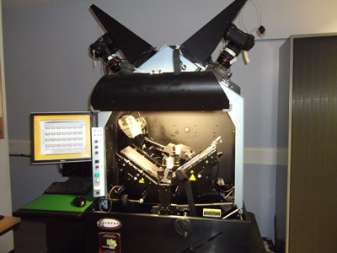
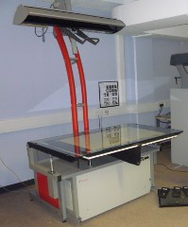
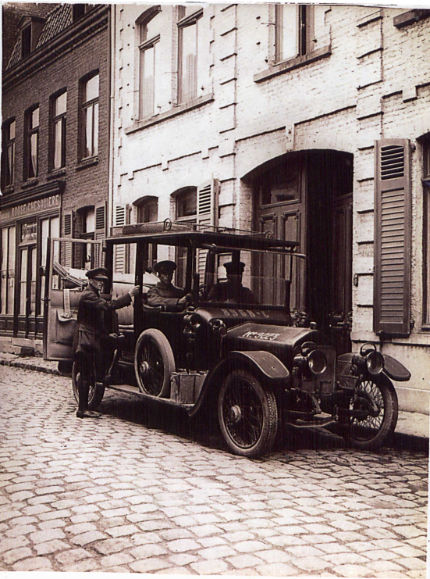
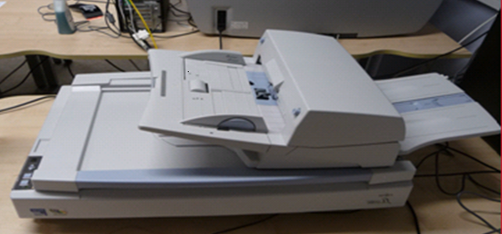
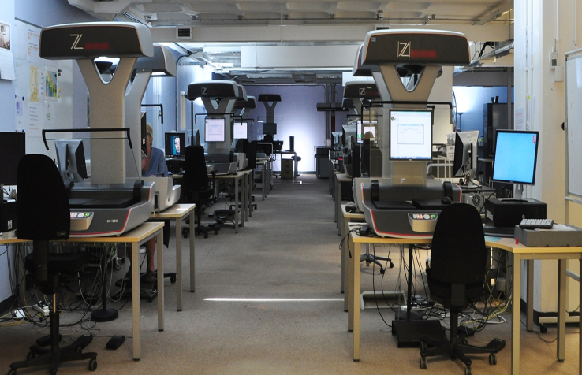
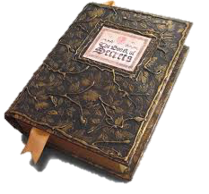
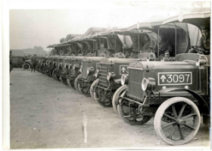
Scanning – Imaging North

Slide 10
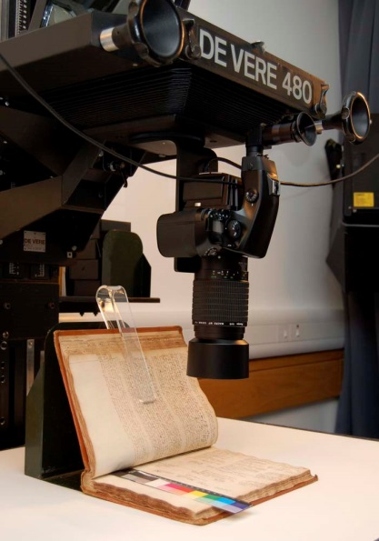
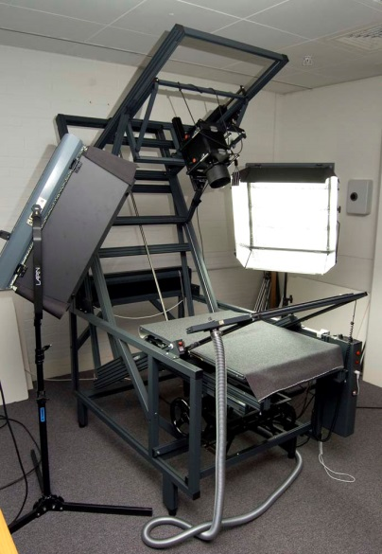
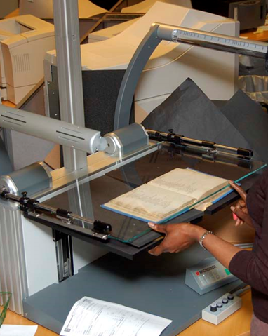
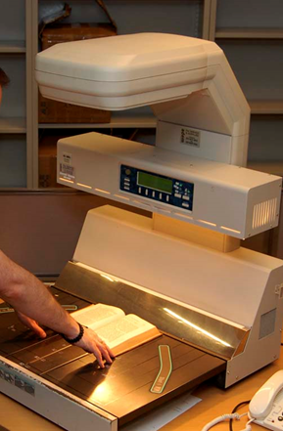
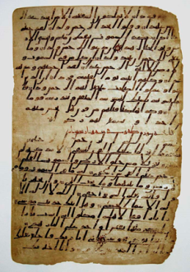
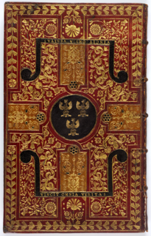
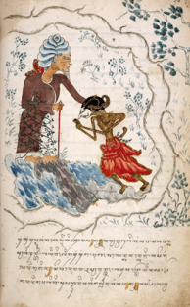
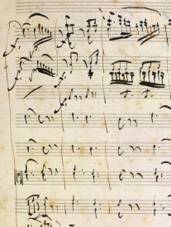
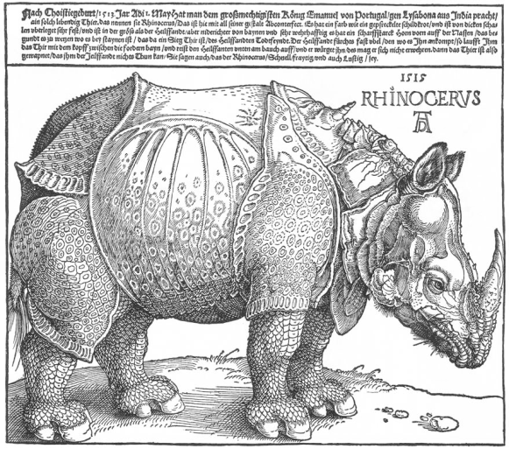
Photography and scanning – Imaging South

Slide 11
What does the British Library digitise?
Our own collection of out of copyright material to enable
    New ways of research
    Greater access
    Preservation/conservation of the original artefact
    A revenue stream
    Or free to view
Other collections via a digitisation service
    Publishers for back-file projects
    Libraries and archives
    Government departments
    Professional societies

Slide 12
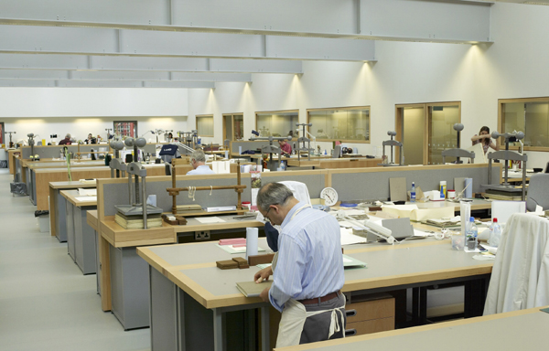
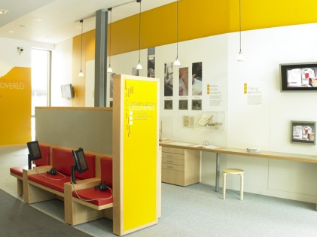
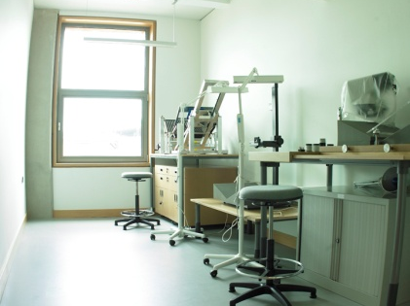
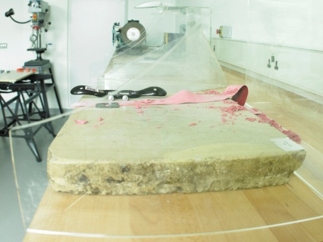
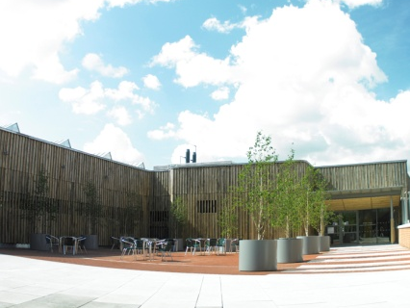
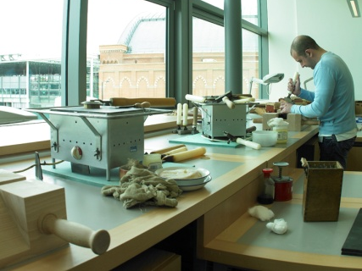
BL Centre for Conservation and Preservation
Centre of Excellence in London with satellite operation in Yorkshire.
Conservators treat damage and deterioration to ensure items are
stable and accessible.
Imaging staff are regularly updated on appropriate handling and processing techniques.

Slide 13
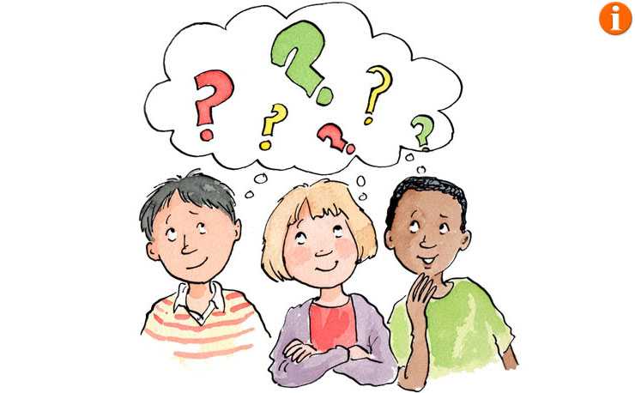
Your thinking!

Slide 14

Conclusions

Slide 15
The British Library
Thank you
Samantha Tillett – Head of Business Development, Partnerships and Licensing
Richard Ebdon – Business Development Manager

