Slide 1
Interlend 2015: Interlending at a Crossroads
Instant fulfilment: Using Patron Driven Acquisitions to satisfy Interlibrary Loans at the University of Sussex
Annette Moore, Technical Services Librarian, University of Sussex, June 2015

Slide 2
Introduction
Patron Driven Acquisitions (PDA) at the University of Sussex
Enhancing user services using EBL ebooks
Pilot Interlibrary Request service for instant fulfilment for book requests using EBL ebooks
Results of the Pilot
Moving forward with ebooks

Slide 3
PDA at University of Sussex
Setting up PDA with EBL
August 2012: Initial profile set up in EBL with 47,000 titles loaded into the Catalogue selected from a back catalogue of around 450,000 titles.
Proved very popular with our users and the budget was quickly spent.
Profile reviewed at the end of the year and limited to recently published titles as well as subject area and cost.
Profile removed from the Catalogue - only MARC records for purchased titles added to the Catalogue.
All titles within the Sussex EBL profile searchable through the Library’s Online Resources

Slide 4
PDA at University of Sussex
Access Model:
Free browse period of 5 minutes for non-owned titles, 10 minutes for owned titles
1st, 2nd & 3rd access = 24 hour rental, 10% of cost of eBook for each rental period / short loan.
4th short loan activates an auto-purchase, 100% cost
Total cost of a purchased ebook is 130% of normal ebook cost.
Non-linear™ Lending allows multiple-concurrent access to all titles up to 325 ‘loans’ or ‘credits’ per year. Renewing automatically annually. Loan = 24 hours view / download = 1 credit

Slide 5
Enhancing user services using the EBL full catalogue of ebook titles
With an extensive catalogue of over 450,000 titles at our disposal, what other services could benefit from instant access to ebooks?
Immediate purchase through EBL of titles on course reading lists. EBL titles are ordered on Coutts OASIS, as this fits in with the Acquisitions workflow.
Instantly satisfying users’ needs when items are reported ‘suspected missing’ at the Information Desk. EBL full catalogue searched and title activated if available.
Instant fulfilment for interlibrary loan book requests. Taken forward as a Pilot service February to July 2013.

Slide 6
Pilot service for instant fulfilment using EBL eBooks
Launched in Feb 2013 as part of a new desktop delivery service for Interlibrary Loans:
New online request forms for ILL : Book Request / Article Request
Default delivery method for journal articles set to ‘Secure Electronic Delivery’ direct to the requestor’s email address (other options available)
For Book Requests, first offered access to ebook, where available (although can ask for print copy if preferred).
Using the same access model as for PDA (3 short loans, 4th loan triggers a purchase)
Limited to ebooks up to £150 purchase price
A budget of £5,000 for the 6 months Pilot

Slide 7
Setting up the Pilot service
A new list was set up in EBL LibCentral (Admin side of EBL) for Interlibrary Loans
A new fund code was set up in LibCentral to monitor expenditure
Desktop delivery was promoted to our users with full details on our Interlibrary Loan webpages
Notes:
As with PDA, there were risks involved around budget but also, would our ILL users accept an ebook or would they prefer the traditional interlibrary loan print copy from the British Library?

Slide 8
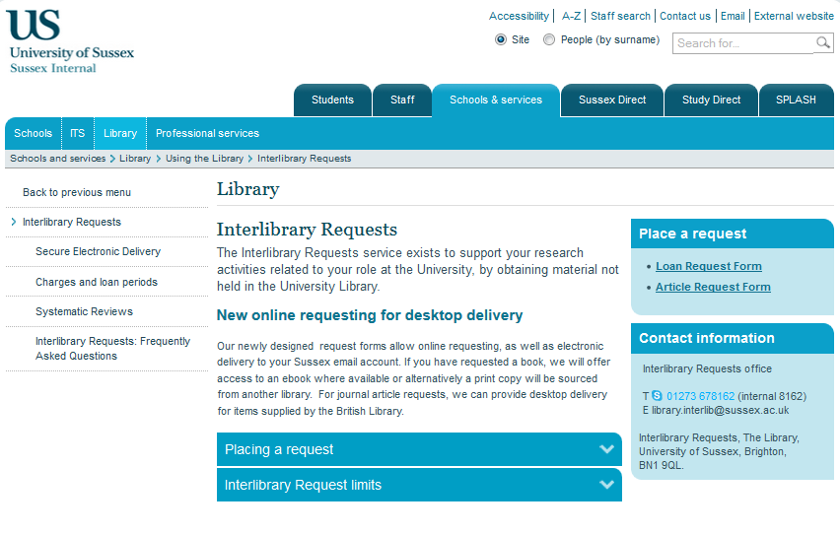
Interlibrary Loan Service
http://www.sussex.ac.uk/library/info/ilr

Slide 9
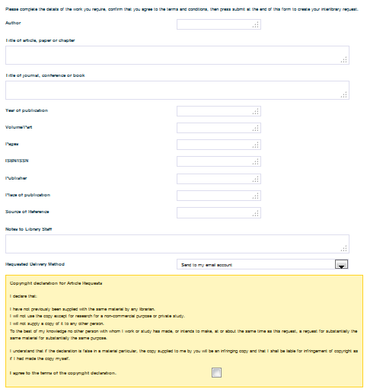
Online request form: Article Request
£2 charge for obtaining an ILL
Choice of delivery method:
Send to my email address
Collect from the Info Hub
Send to my campus address
Send to my home address
Copyright declaration form -tick box to confirm agreement

Slide 10
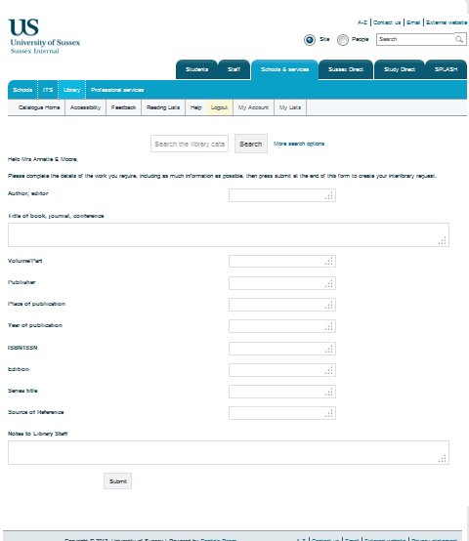
Online request form: Book Request
Charge for obtaining a traditional ILL is £2.
No charge for satisfying by providing access to EBL ebook

Slide 11
Running the Pilot
Title search for all Book Requests on Library Search (Primo)
ISBN / title search in EBL full catalogue
If found on EBL, check price, activate the title, add to the ILL list and add fund code.
Notify user and send durable url link to access ebook.
LMS Interlibrary Loan record updated as ‘satisfied by EBL’
Tracked spend and usage through LibCentral
Once an ebook title is activated, it becomes immediately visible in our Sussex EBL collection, discoverable from our Online Resources or Library Search.

Slide 12
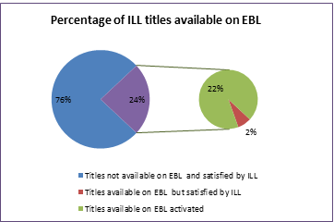
What did the Pilot service tell us?
Availability
24% of ILL Book Request titles (238) were available through EBL
Of these, 220 were activated and 18 were not, as the requestor’s preference was for a print copy.
Reasons given for requiring print copy:
Needing to read the entire book
Technical restrictions on number of pages that can be printed.
Preference always for a print copy

Slide 13
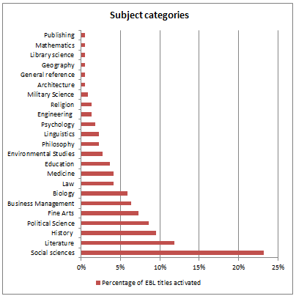
What did the Pilot service tell us?
Subject coverage
A breakdown of traditional Interlibrary Loans by requestor and department, gives the top 5 subject areas as : English Literature, Art History, History, International Relations and Politics and Media and Film.
Top 5 subject categories used to satisfy ILL with EBL:
Social Sciences : 51 titles
Literature : 26 titles
History : 21 titles
Political science : 19 titles
Fine Arts : 16 titles
With content from key academic publishers, EBL offers a wide range of academic material that matches the needs of our users.

Slide 14
What did the Pilot service tell us?
Usage
220 titles activated
11% of titles became automatic purchases
30% of titles were only accessed once
14% had two short loans
15% had three short loans
30% were browsed for less than 5 minutes therefore no loan triggered
Does this last figure equate to the number of traditional interlibrary loans returned uncollected or unused?

Slide 15
What did the Pilot service tell us?
Costs
Total cost for access to 220 titles over 6 month pilot: £3,874
Average cost of an automatic purchase: £78.08
Average cost of titles with 1-3 short loans: £15.38
Overall average cost per title: £17.61
Comparative cost for traditional ILL during the pilot: £12.50 (BL charge plus postage, minus £2 borrower charge)

Slide 16
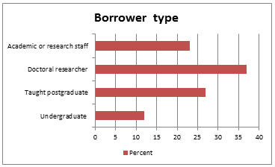
What did the Pilot service tell us?
User Activity : Use by Borrower Type
Doctoral researchers : 37%
Taught postgraduates : 27%
Research staff : 23%
Undergraduates: 12%
Similar figures for the breakdown of Interlibrary Loans by borrower type for traditional ILL service, indicates that the range of material offered by EBL generally meets the needs of our users.

Slide 17
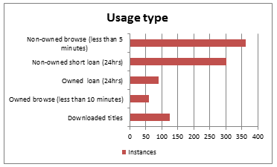
What did the Pilot service tell us?
User Activity : usage types
Significant use of the free browse period was an unexpected outcome. Initial concerns were that most usage would result in an automatic purchase.
50% of titles were downloaded to a range of devices, with very few technical queries or problems.

Slide 18
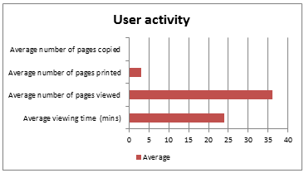
What did the Pilot service tell us?
User Activity: viewing and printing
Average viewing time for a title: 24 minutes
Average number of pages viewed: 36
Users dipping in to a book rather than reading cover to cover
Average number of pages printed: 3
Minimal copying of text from pages to another source

Slide 19
Summary of key findings
Overall the feedback from users has been very positive
Users very impressed with the speed of delivery offered by desktop delivery for Book Requests.
A small number of users would always prefer a print copy, others would only prefer print copy if reading the whole book
With over 450,000 titles from key academic publishers, EBL offers a wide range of academic material that matches the needs of our users.
24% of ILL book requests were available on EBL
Some interesting insights into user activity: browsing, time online, number of pages viewed or printed
Overall average cost per title: £17.61 – comparable to the cost of a traditional interlibrary loan, additionally purchased 24 ebooks within this cost.
We have continued to use EBL to satisfy ILL Book Requests, however pricing this year for short loans has gone up considerably, particularly for some publishers, so we will need to re-evaluate costs for the year.

Slide 20
Moving forward with ebooks …
Looking at other options for access to ebooks
In the Library - Evidence-based Acquisition as a possible alternative to PDA, where the library pays an up-front fee for a particular collection. The content is then made available and usage recorded via COUNTER statistics. After 6 months or a year, the library then buys books, based on usage, up to the value of the up-front fee.
Working with specific Schools to provide access to digital content for key text books through Kortext.
Notes:
libraries pay an up-front fee for a particular collection that interests them. The content is then made available and usage recorded via COUNTER statistics. After six months or a year the consortium then buys books, based on use, up to the value of the up-front fee.

