Slide 1


Inter Library Loans at the University of Hertfordshire
using the Koha Open source LMS and the British Library API for unmediated ILL requests
Sarah Halliday, Content and Collections Consultant
University of Hertfordshire
https://library.herts.ac.uk/

Slide 2
Some background – University of Hertfordshire
University of Hertfordshire
  post-1994 University
  medium sized teaching university
    24,4800 students, predominantly on taught courses
    30% part-time
    22% post-graduate (20% taught courses, 2% research)
    17% international students (majority non-EU)
  Subjects: Medical and health sciences (25%), Business (17%), Creative Arts (10%), Education (10%)
  Strategic focus on fostering and strengthening research
Content and Collections Team (Library and Computing services)
  ‘traditional’ library functions – acquisitions, cataloguing, journals, library systems, ILL
  usage statistics collection and analysis, e-resource management, licensing
  development and project work

Slide 3
More background - Inter Library Loans at UH
1999–2015
  bespoke server based scripts on Voyager LMS (Ex Libris) facilitated unmediated ILLs
Unmediated ILLs: unlimited ILLs for any member of staff or student at no cost to the patron
  How?
    form on OPAC enabled patron to submit request
    Overnight, automated process emails it to BL via ARTEmail
  Why?
    Cost savings (staffing)
      ILL functions carried out by Content and Collections Team, 1 member of staff with responsibility for ILL alongside other duties
    efficiency for patrons

Slide 4
2015 – year of change
2015 – UH changed to Koha LMS (open source)
  no ILL module suitable for unmediated workflow
2015 - BL introduced API
  new API
  Intention to stop ARTEmail service

Slide 5
The solution!
PTFS (Koha support) to the rescue
  UH provided a detailed process map and procedures
  PTFS created ILL module to suit our need for unmediated requests
ILL module for Koha, created by PTFS
  interrogates BL catalogue using the API and sends requests for found articles off directly
  records manual requests and book requests in Koha, which are then dealt with by our team
Concerns
  increased numbers of requests as system became more automated
  User difficulties in adapting to the new system

Slide 6
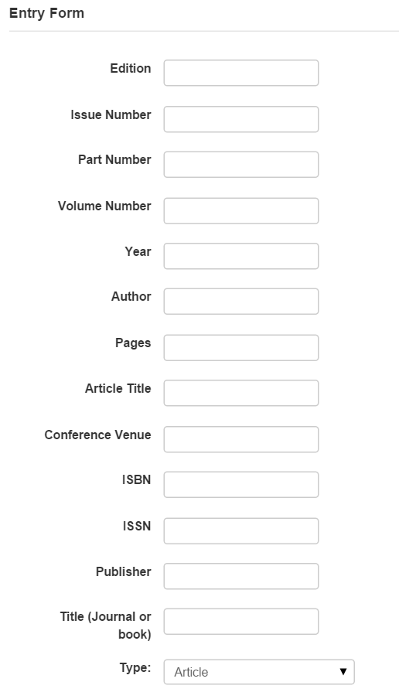
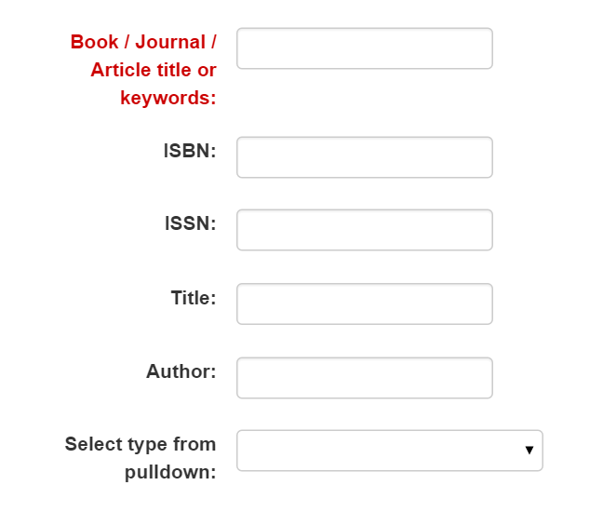
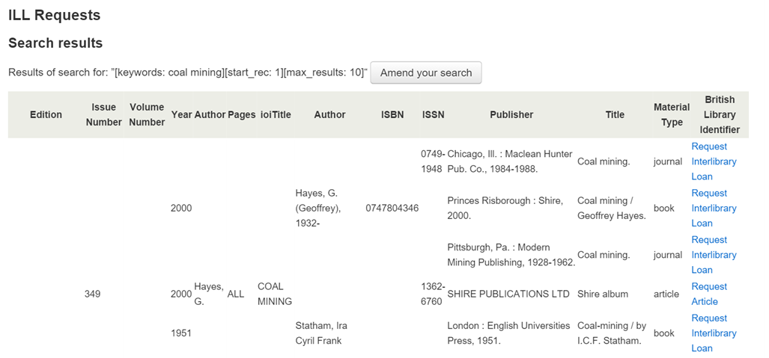

The process for patrons – placing a request https://library.herts.ac.uk/
Returns results from the British Library, with option to place request
If the correct item is not shown in the BL results, there is an option for a manual request
In Summon – option to request non-UH items
Search form in Koha

Slide 7
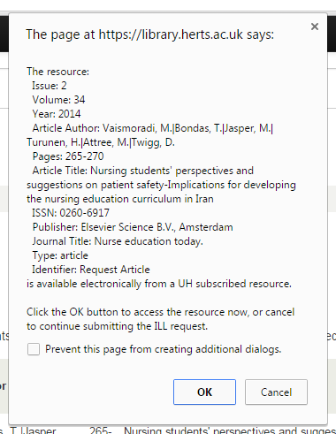
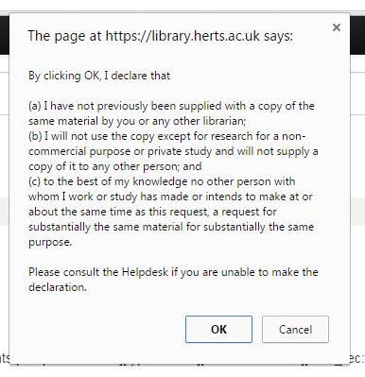
Helpful pop-ups …

Slide 8
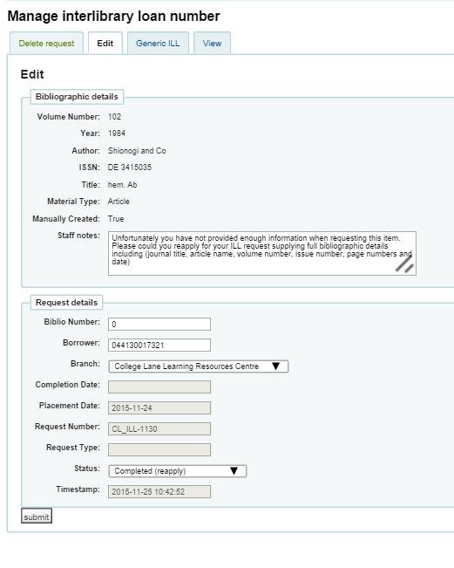
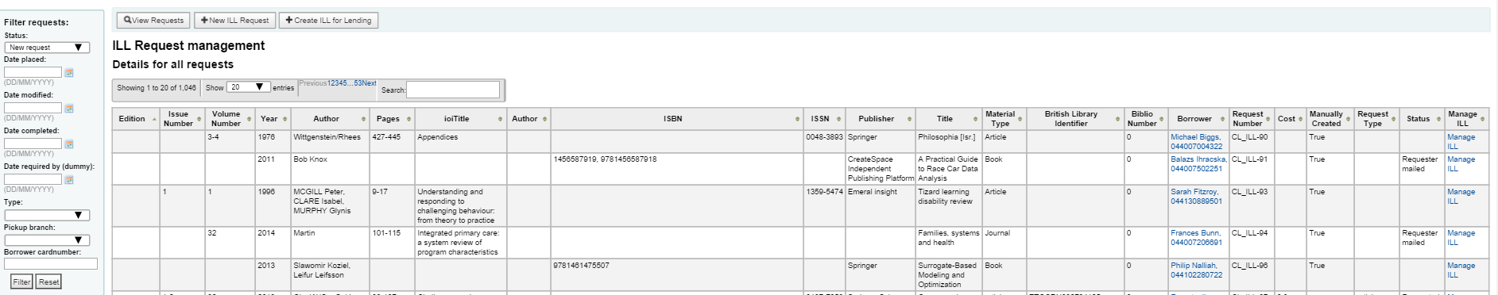
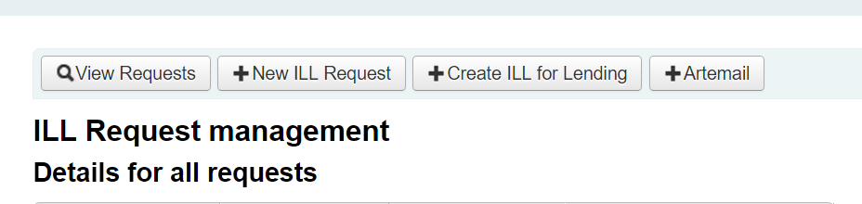
Process for staff – managing requests
Some requests
need further details
Once all request details completed, a script is run to bundle the requests up and send to BL via ARTEmail

Slide 9
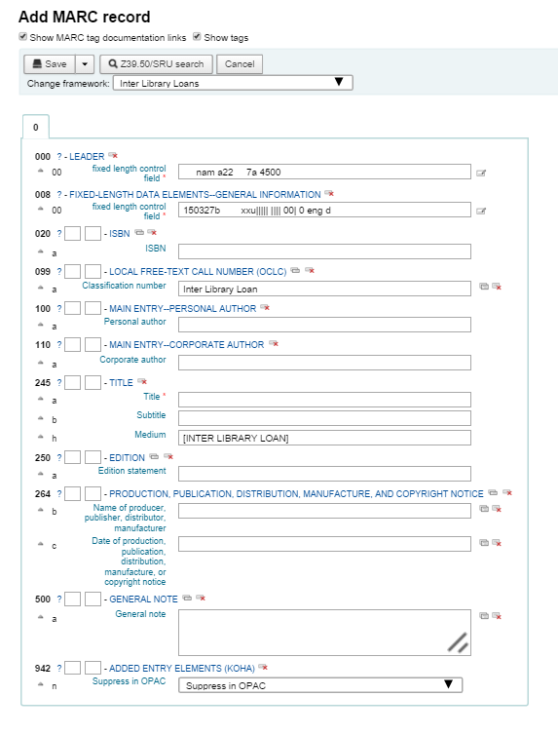
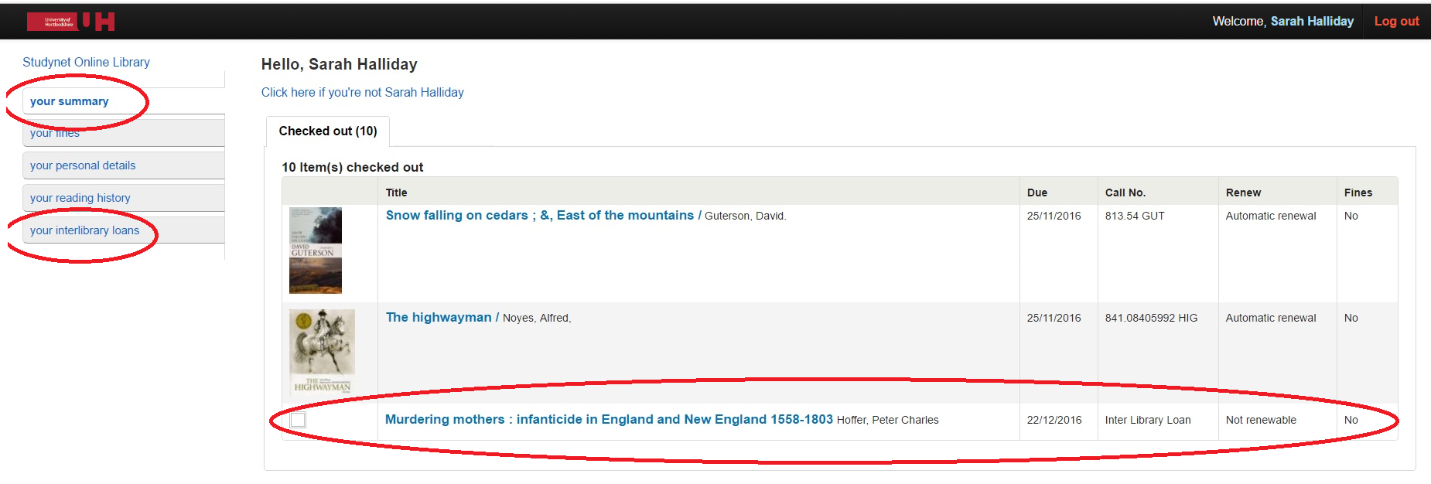
Issuing and returning ILL loans
Inter library loan on a patron account
ILL biblio frame-work for issuing
items

Slide 10
Initial issues and solutions
Manual submission of requests to BL was time consuming
  Now we have a script to bundle manual requests, send them via ARTEmail and update Koha
Difficult for users to tell the status of a request from their patron record on Koha
  Created more meaningful statuses which also appear on the OPAC patron record- eg Item returned
BL API is relatively untested and incomplete holdings mean items not being found
  in discussion with the BL to help develop the API

Slide 11
How is it working?
Numbers of ILLs at UH over 10 years …

Slide 12
How is it working?
More detail
54% of SED delivery fully automated
  why not all via API?
    API limitations
    User preference
45% requests placed by staff / 55% by students
  further breakdown by school /type of student / course
    Limitations of information currently available

Slide 13


How is it working?
Questions raised and future developments
Future development work by PTFS, streamlining processes by us, BL development eg.:
  Speed up staff interface - PTFS
  Record when articles found via 360 link so we can monitor cost savings - UH
  enable use of DOIs - BL
Ideal workflow for placing an ILL request
Item not found in Summon
ILL option appears,
pre-populated with metadata from Summon
ILL form is item specific, with compulsory fields for item type
Form data is used to search BL API
If no match, manual form appears, pre-populated with search terms as before

Slide 14
In conclusion
PTFS developed an effective ILL module with improved functionality, with our input
  Not a like-for-like replacement – has made us map processes and examine workflows forensically – lots of questioning!
  Consulted with our users and find out their needs and preferences
Speedier SED delivery for our users
Opened up dialogue with BL over API development
  although ARTEmail now remaining …(phew!)
Great opportunity for team working and raising awareness of ILL processes for all members of team
Providing detailed statistics to use for service monitoring, planning and changes

Slide 15
Thank you!
Sarah Halliday s.1.halliday@herts.ac.uk
Content and Collections Team
Library and Computing Services
University of Hertfordshire

